Slide 1
Family Ties

Slide 2
Backwards Communication

Slide 3
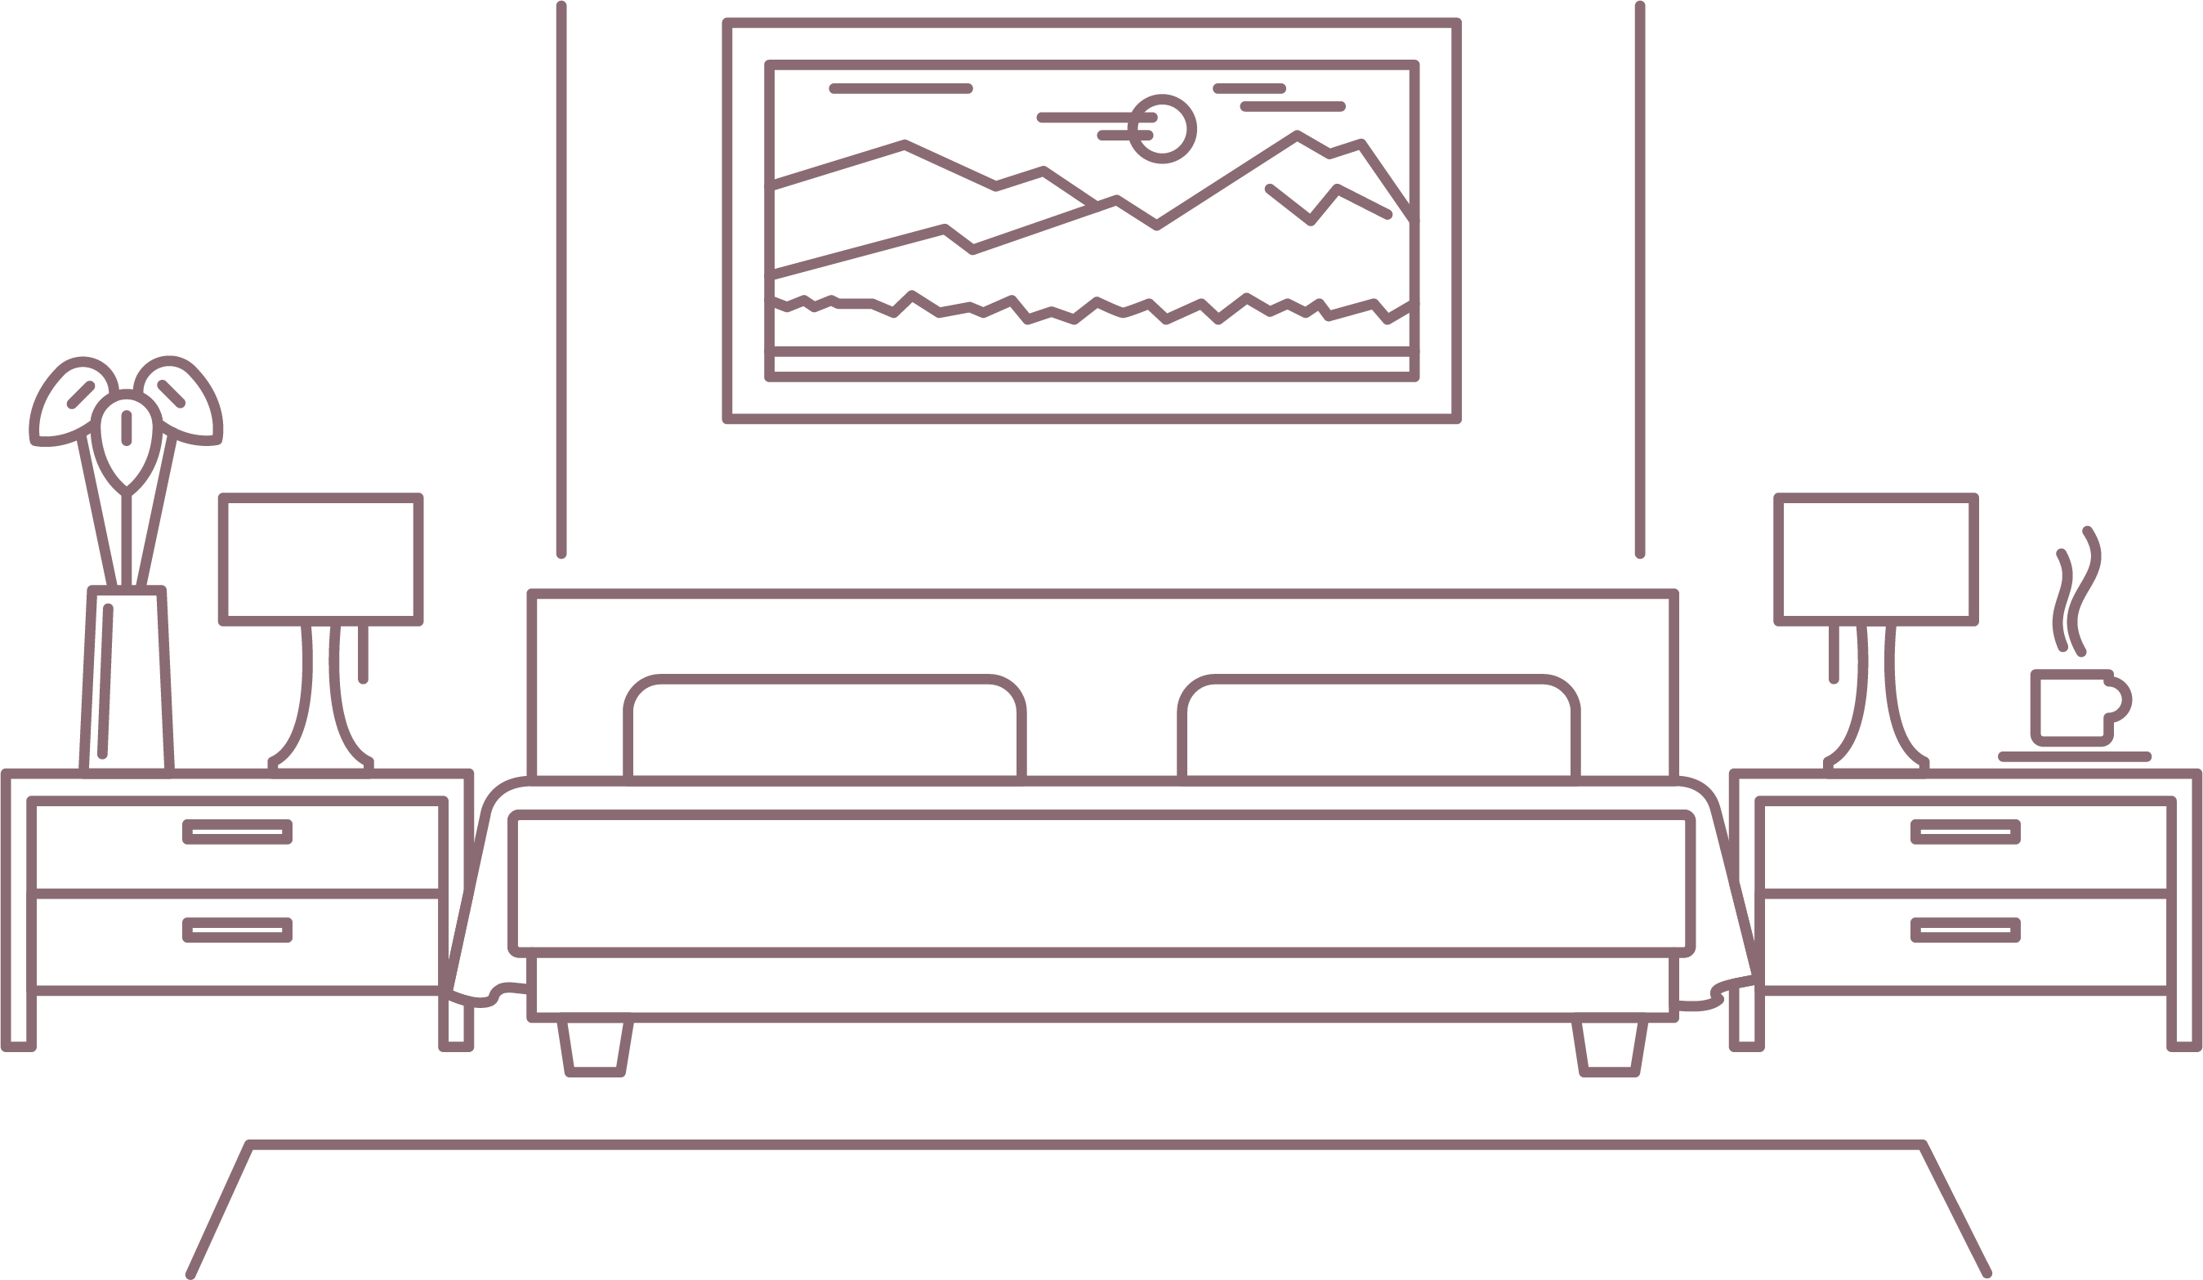
Image by Macrovector from Freepik.com

Slide 4
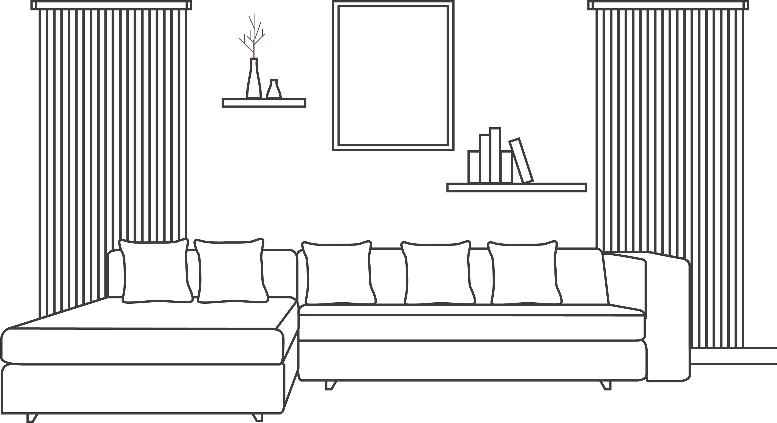
Image by Freepik.com

Slide 5
Discuss:
Was this task easy or difficult? Why?

Slide 6
Discuss:
What role does communication play in our lives?

Slide 7
Where We’re Going:
The member will be able to identify and demonstrate characteristics of effective communication in family, work, and community settings.
The member will be able to identify communication barriers and apply strategies to overcome them successfully.
The member will be able to devise a project to improve his or her family based on a SMART goal for the “Family Ties” Power of One unit.

Slide 8
How We’ll Get There:
What is effective communication and what does it look like?
Barriers to effective communication
Strategies to overcome those barriers
Analyzing communication in different contexts
Power of One: Family Ties

Slide 9
Effective Communication

Slide 10
“Most people do not listen with
the intent to understand; they
listen with the intent to reply.”
-Stephen R. Covey

Slide 11
Communication: The two-way process
of reaching mutual understanding, in which participants not only exchange information, news, ideas and feelings
but also create and share meaning.
Source:
http://www.businessdictionary.com/definition/communication.html

Slide 12
Think:
What is communication in your own words?

Slide 13
Four Forms of Communication:
Verbal
Face-to-face, TV, radio, telephone, other media
Nonverbal
Facial expressions, body language, dress, scent
Written
Pen and paper, e-mail, social media, magazines, books, text messaging, the internet
Visual
Maps, logos, charts, graphs
Source:
https://www.skillsyouneed.com/ips/what-is-communication.html

Slide 14
Three Parts of Communication:
Sender
Encodes a message verbally and nonverbally or in writing or graphics
Message
What is actually communicated; May be effective or ineffective
Receiver(s)
Responsible for decoding the sender’s message; May interpret the message differently than the sender intended
Source:
https://www.skillsyouneed.com/ips/what-is-communication.html

Slide 15
The Seven C’s of Communication:
Clear
Make your objective clear by avoiding complex phrases and words
Concise
Keep it to the point to avoid confusion
Concrete
Use support for the message to validate what is said
Correct
Speak truthfully and use correct grammar
Source:
https://expertprogrammanagement.com/2018/04/7-cs-communication/

Slide 16
The Seven C’s of Communication:
Coherent
Messages should make sense and flow
Complete
All necessary information should be communicated
Courteous
Consider the audience and deliver the message with tact
Source:
https://expertprogrammanagement.com/2018/04/7-cs-communication/

Slide 17
Barriers to Effective
Communication

Slide 18
Barriers to Effective Communication
Lack of attention/interest
Distractions
Differences in perception and viewpoint
Expectations and prejudices
Use of jargon
Speech difficulties, language differences
Technological barriers (Unable to see nonverbal communication)

Slide 19
Overcoming Barriers
to Effective Communication

Slide 20
Overcoming Barriers to Effective Communication
Practice Active Listening
Maintain eye contact
Paraphrase a message to the sender to ensure understanding
Ask questions
Be present
Change your mindset
“Most people do not listen with the intent to understand; they listen with the intent to reply.” -Stephen R. Covey
Stop thinking “I must defend my position,” “I don’t have time to listen to everything you say,” “I need an entrance into the conversation,” “I know what you are going to say,” and “I already know what you should do.”

Slide 21
Overcoming Barriers to Effective Communication
Consider the other person’s perspective
How would the other person perceive your words, nonverbal communication, or text or graphic?
What is your audience’s background?
Use “I” messages
“I” messages allow a sender to express strong emotions without attacking the receiver.
“You constantly interrupt me!” vs. “It makes me upset when I am not allowed to finish my sentence.”

Slide 22
Brainstorming Matrix: What does communication look like in these contexts?
Family
Community
Career

Slide 23
Context | What forms of communication happen in this context? Give specific examples.
What are potential barriers to effective communication in this context? Give specific examples. | How can these barriers be overcome? Give specific examples.

Slide 24
Group Share-Out

Slide 25
Discuss:
Why is communication critical in a family and how does
this impact communication in other areas of life?

Slide 26
Answers:
Needed for healthy relationships, problem solving, and growth.
Healthy families are proven to support productive employees.
Good communication at home teaches good communication in the workplace.

Slide 27
Family Ties
Family Ties is the second unit in the FCCLA Power of One national program.
This unit focuses on strengthening one’s family and home life.
The family is the basic unit of society. By making stronger families, we have stronger communities.

Slide 28
Executing Your Family Ties Project
Brainstorm areas/aspects of your family you would like to improve.
Decide which project area is your top priority.
Make a list of ways you would like to improve yourself in your chosen project area.
Use the FCCLA Planning Process to set a SMART goal to achieve and plan a project to meet your goal.

Slide 29
In Summary…
Effective verbal and nonverbal communication is critical in school, work, communities, families, and electronic contexts.
Numerous barriers to communication exist, but strategies can be used to overcome them.
Family Ties is the second unit of Power of One that focuses on strengthening families and homes.
Your Family Ties project does not have to relate directly to communication, but effective communication must be used in any effort to strengthen a family.

Slide 30
What questions do you have?

Slide 31
Which topics interest you?
Caring for your own space and clothes
Caring for family pet
Making time for family
Keeping up with household responsibilities
Helping with family meal time
Organizing fun family activities
Preparing a family tree or genealogy journal
Accepting family members' viewpoints
Stopping negative talk
Reducing arguments with family members
Improving communication with family members
Improving family relationships
Spending time with parent, stepparent, grandparent, or other relative
Becoming a more responsible family member
Understanding and working toward family goals
Dealing with serious family challenges (such as illness, physical handicaps, divorce, death, suicide, alcoholism, abuse)

Slide 32
What goal do you want to achieve within a topic?
Keep my possessions neat and organized
Organize and maintain my clothes and closet
Feed, exercise, and clean up after the family pet
Set up a "fun at home" night for all family members
Organize and conduct family meetings
Learn about a family member’s career
Participate in FCCLA @ the Table
Plan and carry out family devotions
Babysit younger siblings one night a week so parents can have a night out
Organize a family community picnic
Make a chart to track my household jobs
Plan and carry out a schedule of family car care (washing and/or maintenance)
Collect favorite recipes from grandparents, aunts, uncles, cousins, and create a family cookbook
Interview a parent, grandparent, or other relative about his or her youth

Slide 33
What goal do you want to achieve within a topic?
Interview your grandparents on what a particular aspect of daily life was like when they were your age (favorite foods and their cost, entertainment, important world affairs, etc.) and compare it with your own experiences
Interview older relatives and write a family history
Make a family tree
Call or write a distant relative on a regular basis
Say only positive things about my family
Create a fun activity to do with a brother or sister
Schedule an hour a day to spend talking with family members
Volunteer to take care of an additional household responsibility
Set up and lead a family council meeting
Prepare a family tree or genealogy journal
Create a scrapbook of family photos
Create a family website to share family news with distant relatives
Create a family time capsule
Practice conflict-resolution techniques in the family
Help family members (and self) deal with a family challenge
Other

Slide 34
Use your Family Ties project sheet to begin planning
your project. Remember,
set a SMART goal.

